Slide 1
Increase Customer Stickiness of Kaggle
IE 5374-Sec03-Project1
Group 9
Jiangying Zhong, Ziyi Zheng, Zheng Lu

Slide 2
Contents
Background
Data Explanation
PART ONE
PART TWO
Project purpose
Data Source
Survey in 2018
Survey in 2019
Survey in 2020
Business Questions
Recommendation
PART THREE
PART FOUR
Data Wrangling
Data Visualization
Conclusion

Slide 3
Background
PART ONE

Slide 4
PART ONE Background
Employment
Big Data Era.
DS & ML - Trend
Market Competition
More companies focus on DS & ML training.
Goal
Increase customer stickiness of Kaggle.
Data Sources
Kaggle DS and ML surveys from 2018 to 2020.

Slide 5
Data Explanation
PART TWO

Slide 6
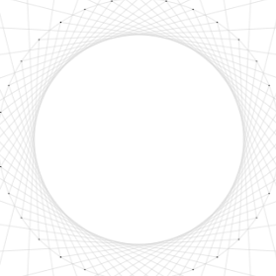
PART TWO Data
Survey in 2018
Survey in 2019
Survey in 2020
age_period2018
genders2018
country2018
coding_period2018
ML_period2018
activities_2018
ml_incorporation_2018
salary2018
platform_usage_2018
age_period2019
genders2019
country2019
coding_period2019
ML_period2019
activities_2019
ml_incorporation_2019
data_science_teams_2019
salary2019
platform_usage_2019
subsurvey_2019_media
age_period2020
genders2020
potential_status
country2020
coding_period2020
language_usage
IDE_usage
ML_period2020
activities_2020
ml_incorporation_2020
data_science_teams_2020
salary2020
platform_usage_2020
subsurvey_2020_media

Slide 7
Business Questions
PART THREE

Slide 8
PART THREE Business Questions
BQ1:
Determine main users of Kaggle.
BQ3:
Clarify market demanding on Data Science and Machine Learning.
BQ5:
Discover the most popular coding language in Data Science and Machine Learning.
BQ7:
Estimate the correlation between Machine Learning and Data Science.
BQ9:
Compare market share of Kaggle within recent years.
BQ2:
Identify potential customer status of Kaggle.
BQ4:
Explore the coding importance in Data Science and Machine Learning.
BQ6:
Evaluate the usage of Kaggle IDE.
BQ8:
Predict the overview of Data Science and Machine Learning.

Slide 9
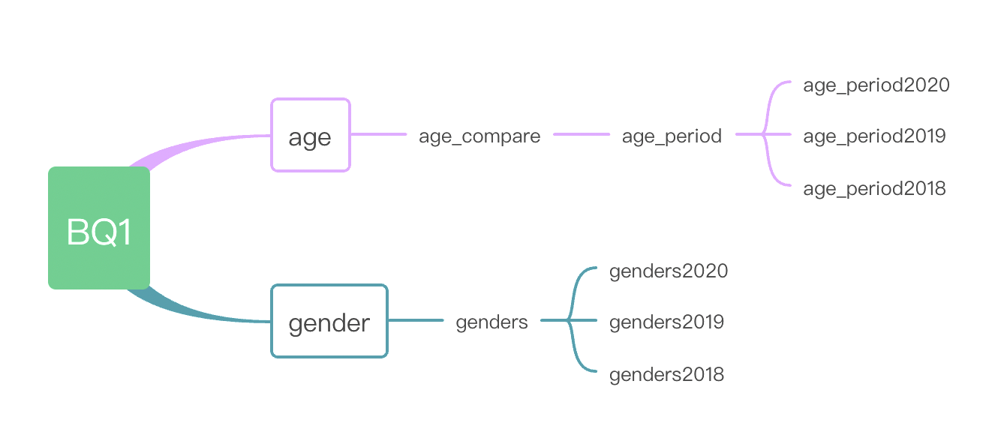
PART THREE Business Questions
Business Question 1
Determine main users of Kaggle

Slide 10
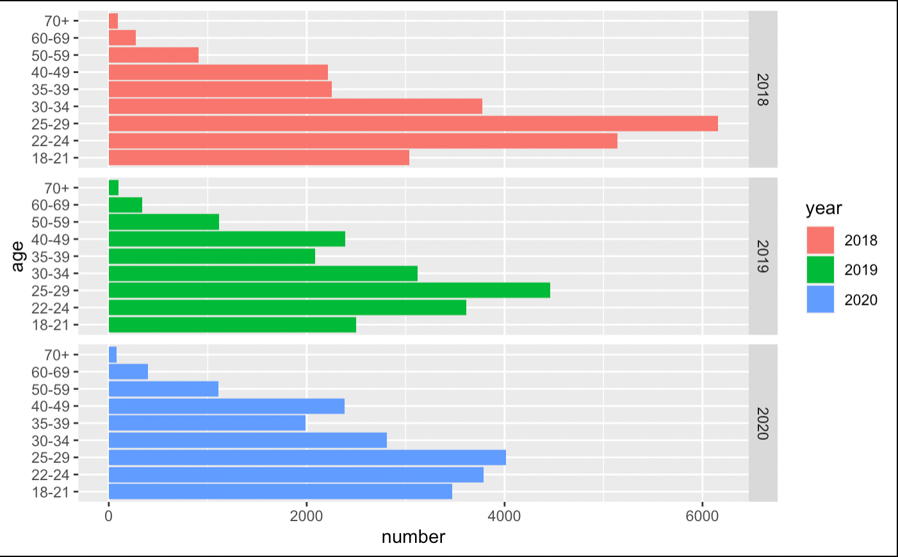
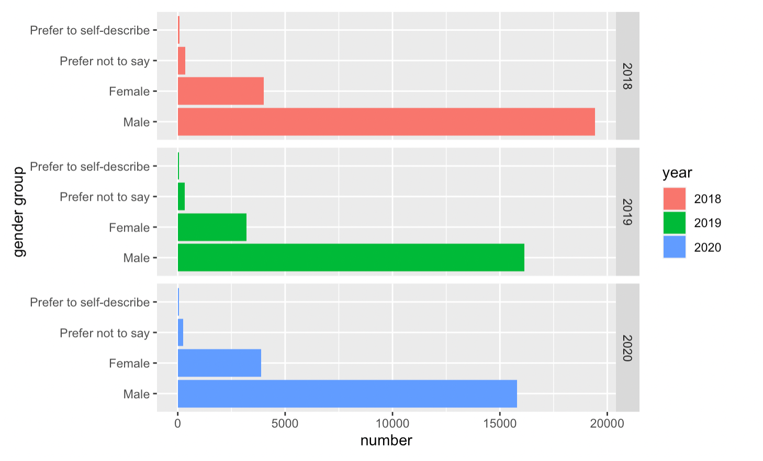
PART THREE Business Questions
Age distribution of participants in 2018-2020
Gender distribution of participants in 2018-2020

Slide 11
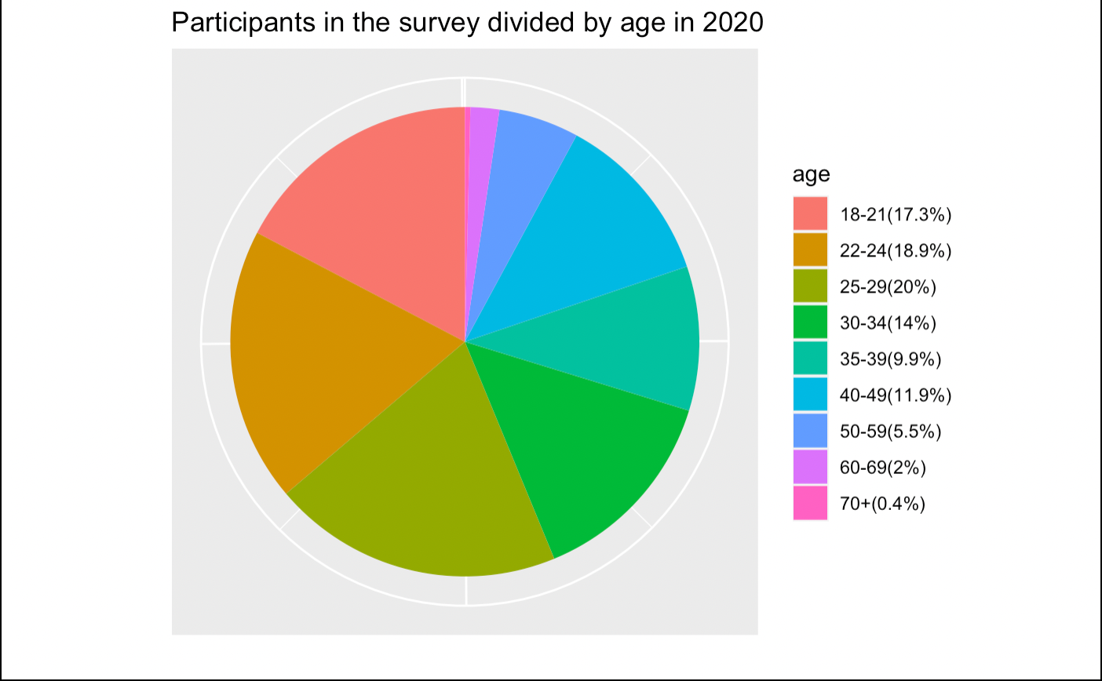
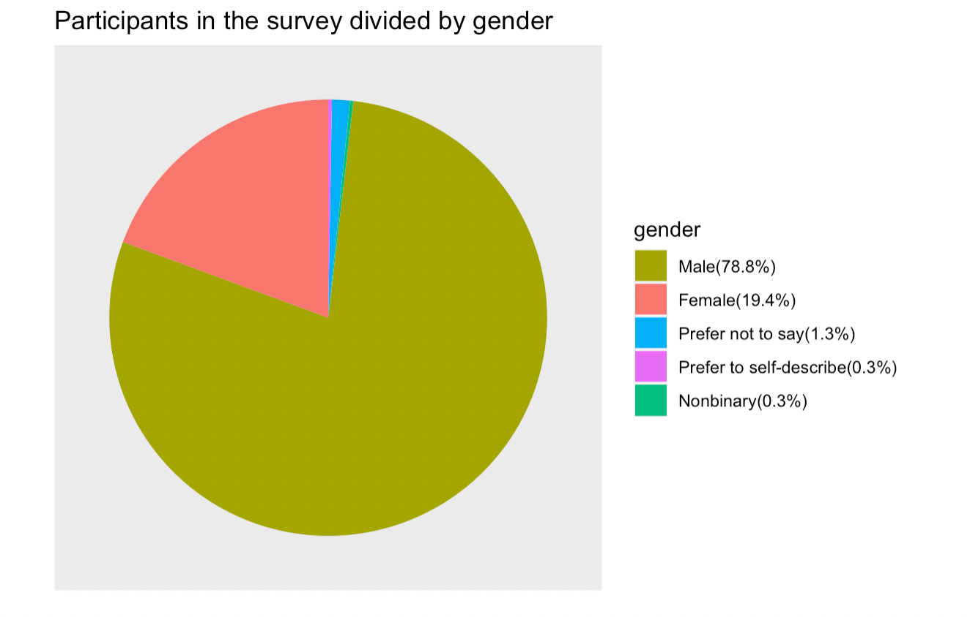
PART THREE Business Questions
Age distribution in 2020
Gender distribution in 2020

Slide 12
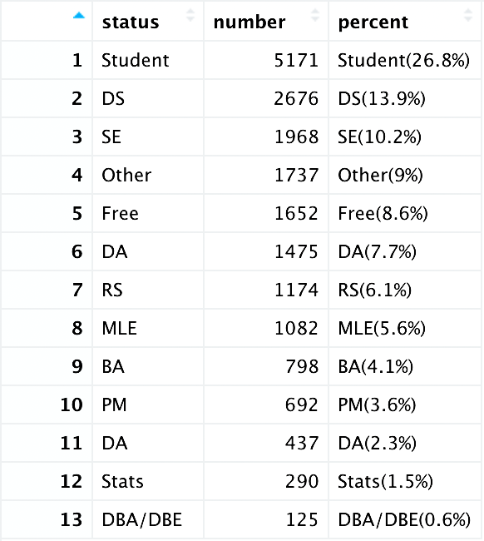
PART THREE Business Questions
Business Question 2
Identify potential customer status of Kaggle

Slide 13
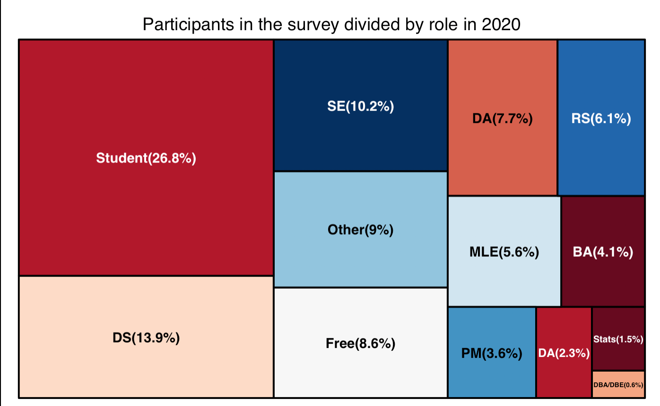
PART THREE Business Questions

Slide 14
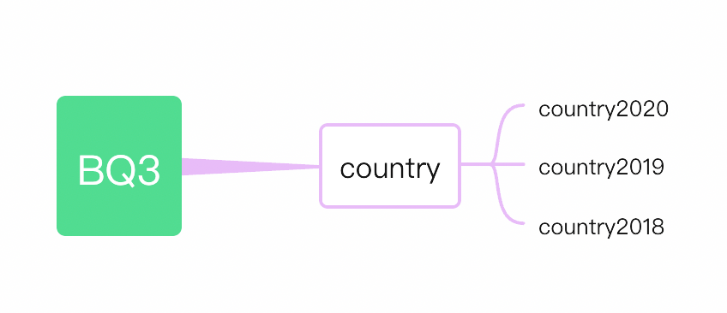
PART THREE Business Questions
Business Question 3
Clarify market demanding on Data Science and Machine Learning

Slide 15
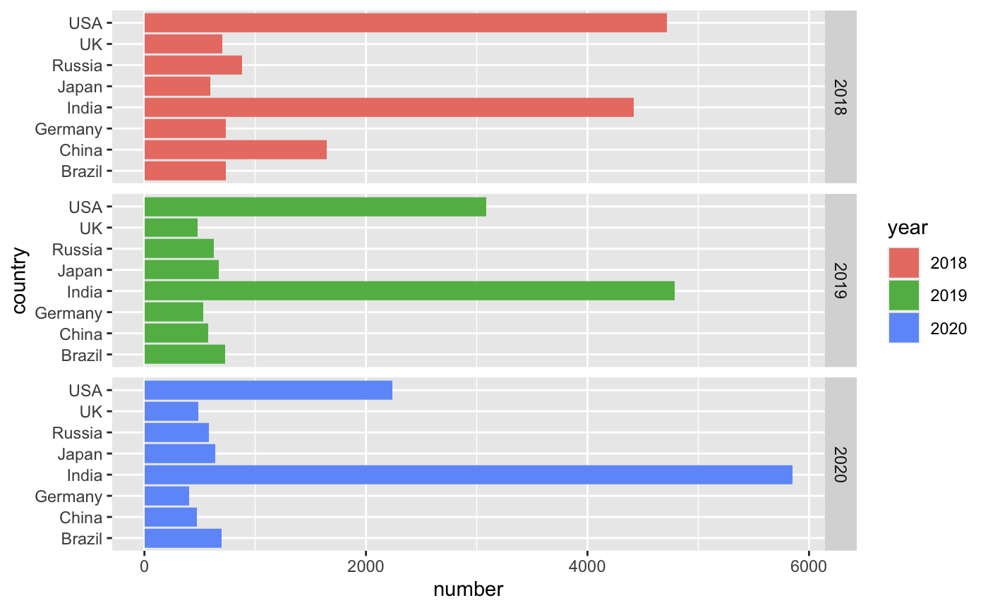
PART THREE Business Questions
Country distribution(part) of participants in 2018-2020

Slide 16
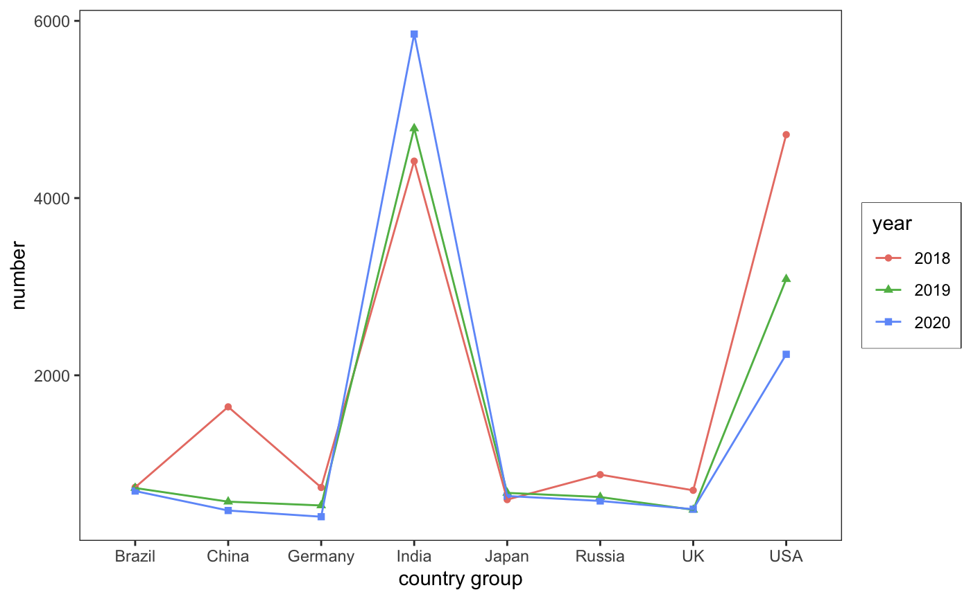
PART THREE Business Questions
Trend of country distribution(part) in 2018-2020

Slide 17
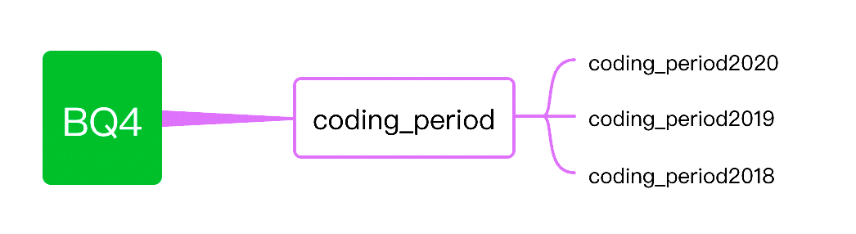
PART THREE Business Questions
Business Question 4
Explore the coding importance in Data Science and Machine Learning

Slide 18
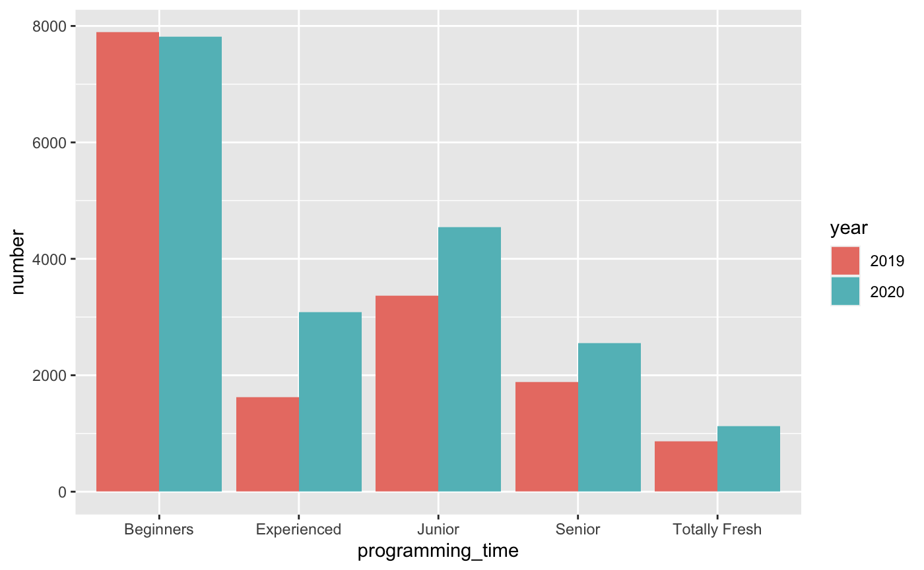
PART THREE Business Questions
Programming levels distribution in 2019-2020

Slide 19
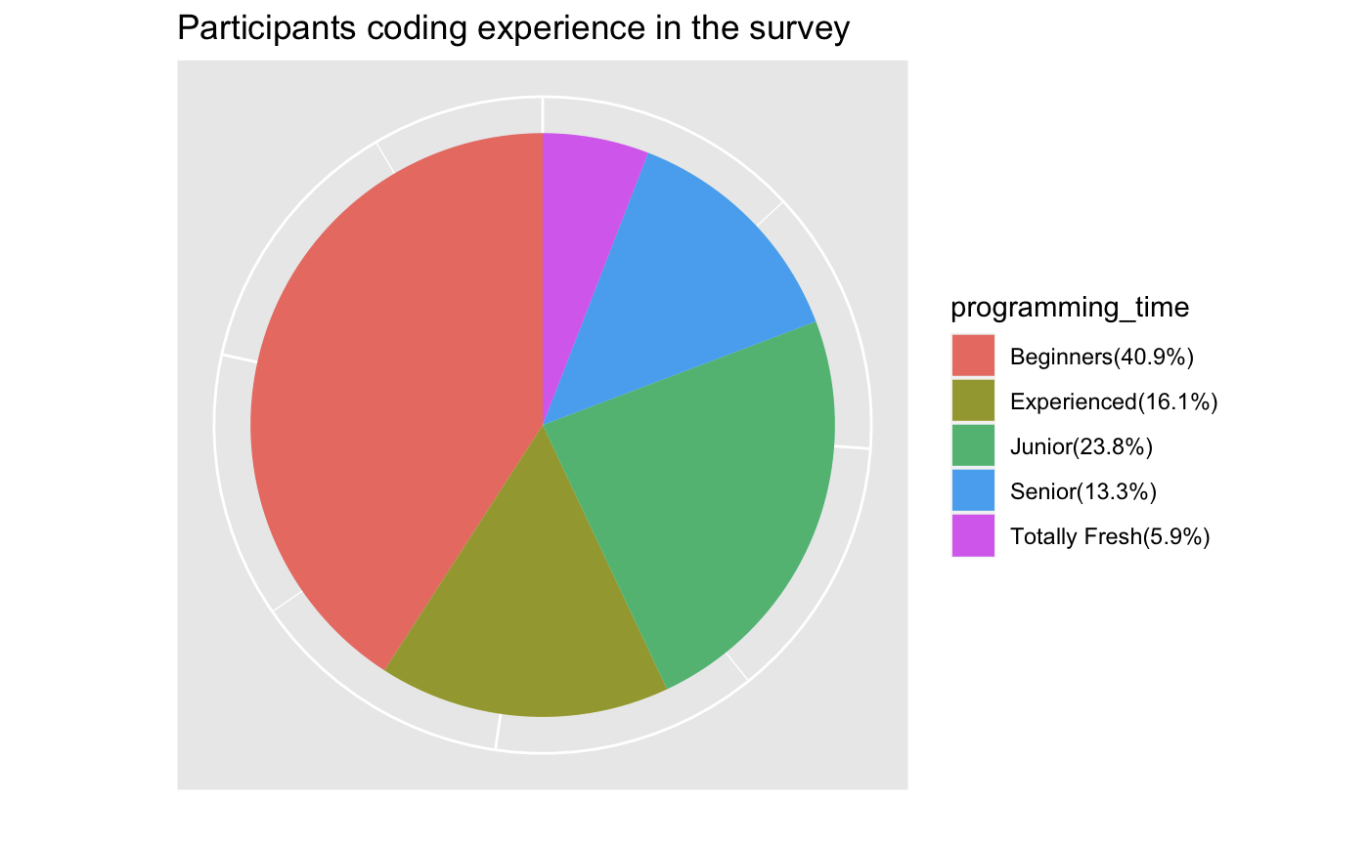
PART THREE Business Questions
Programming levels distribution in 2020

Slide 20
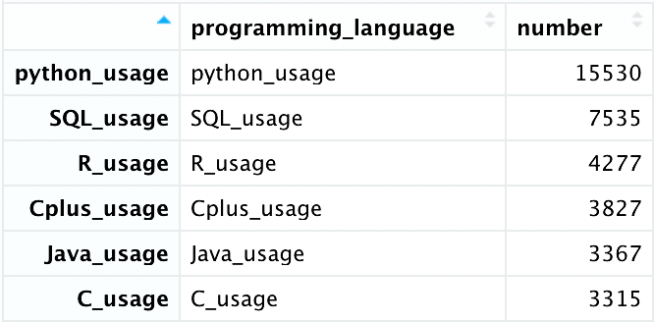
PART THREE Business Questions
Business Question 5
Discover the most popular coding language in Data Science and Machine Learning

Slide 21
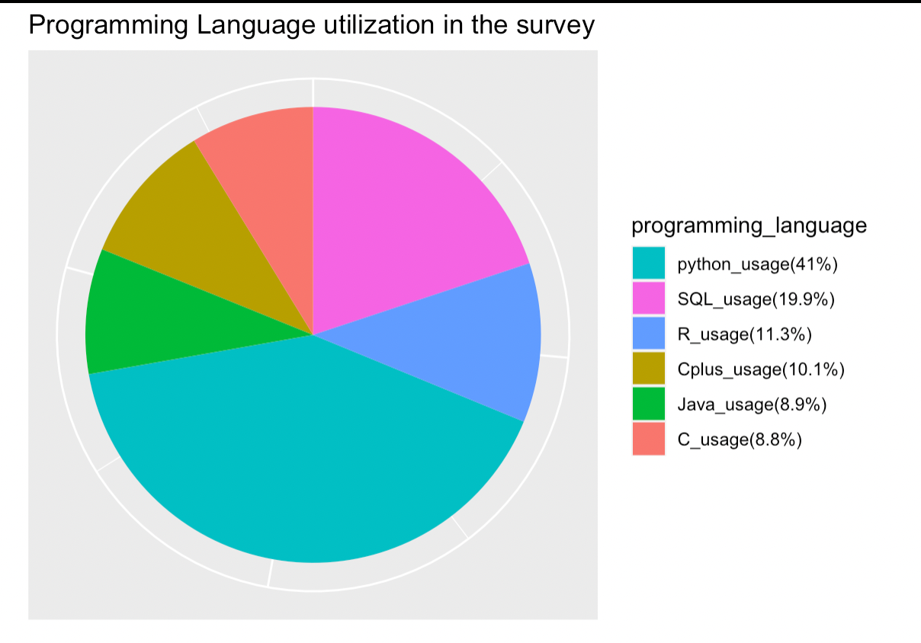
PART THREE Business Questions
Percentage of top 6 programming languages in 2020

Slide 22
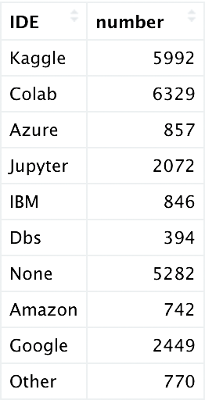
PART THREE Business Questions
Business Question 6
Evaluate the usage of Kaggle IDE

Slide 23
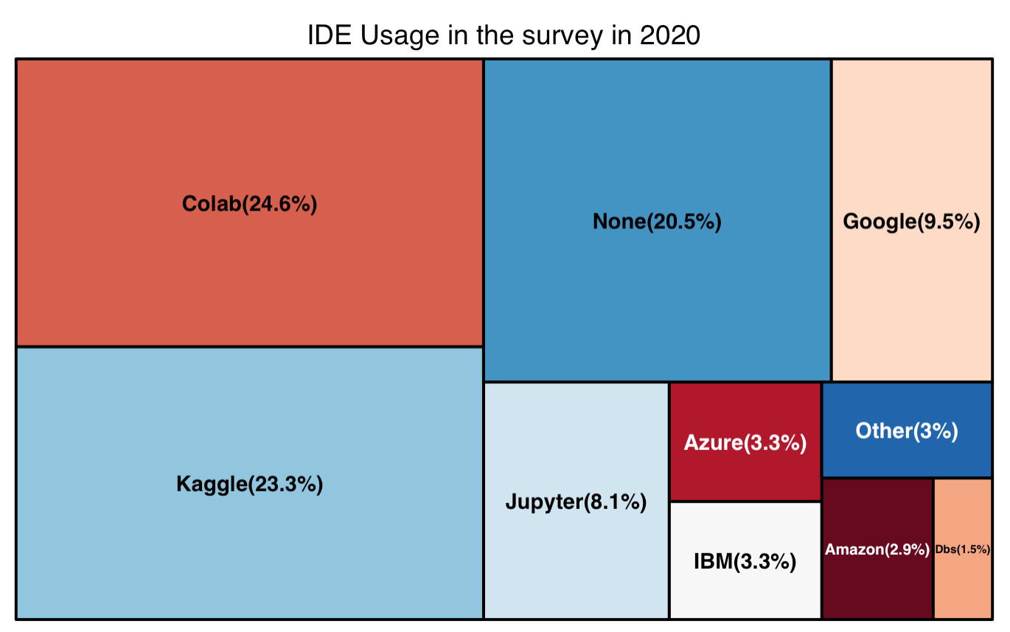
PART THREE Business Questions
Percentage of IDE usage in 2020

Slide 24
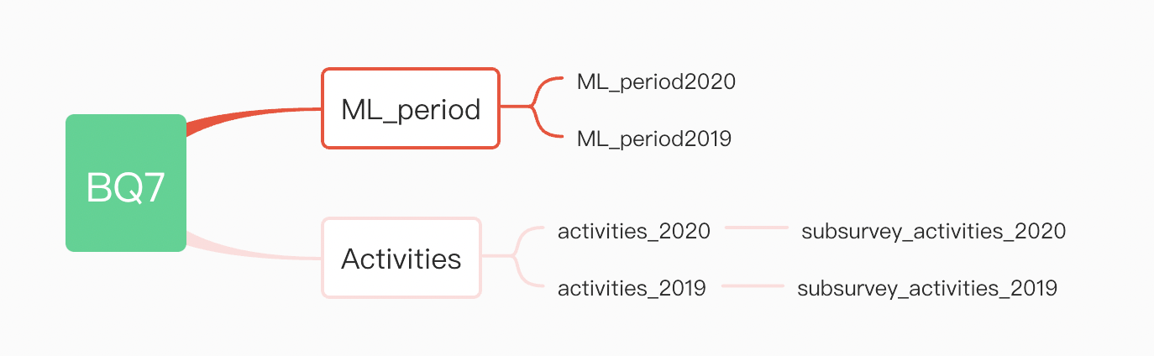
PART THREE Business Questions
Business Question 7
Estimate the correlation between Data Science and Machine Learning

Slide 25
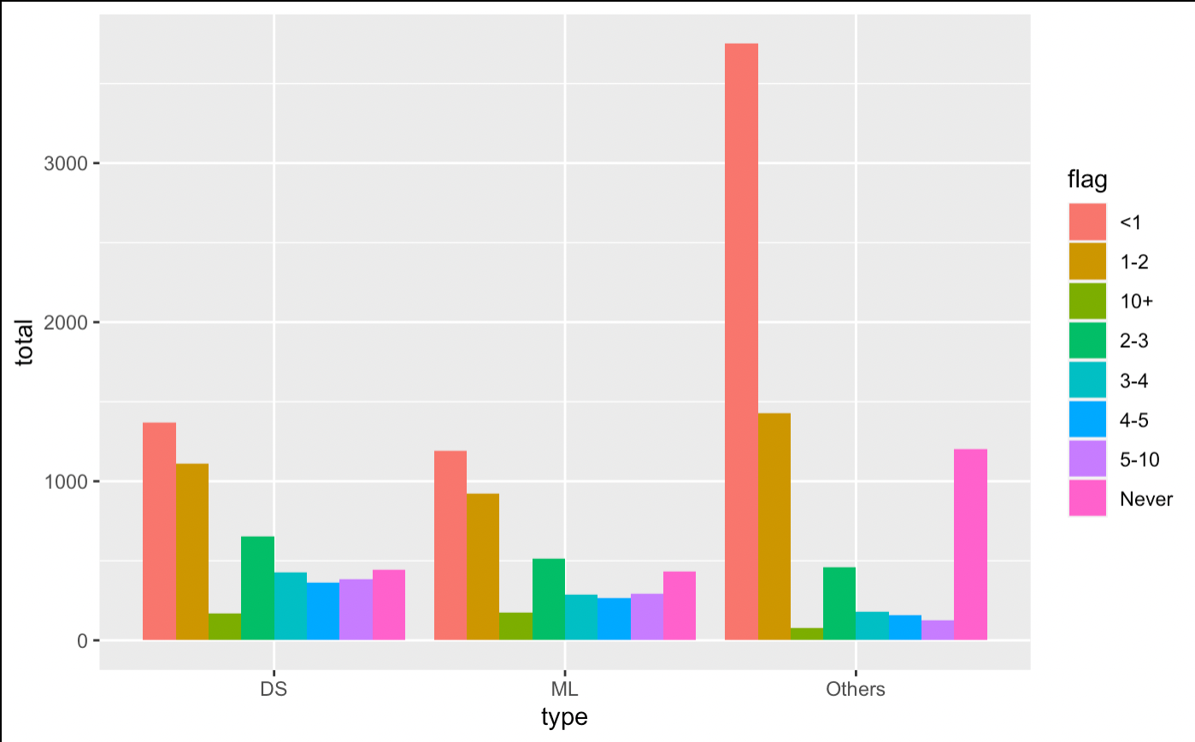
PART THREE Business Questions
DS and ML usage time distribution in 2020

Slide 26
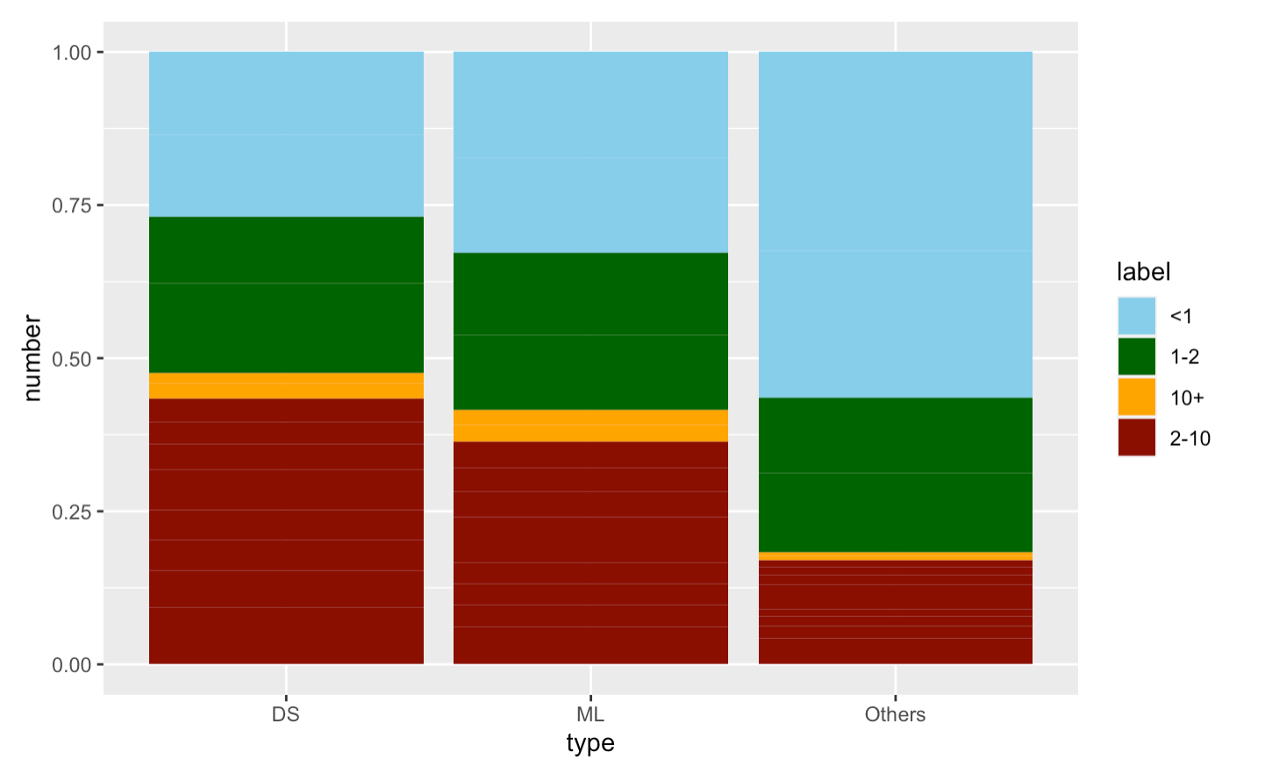
PART THREE Business Questions
Percentage distribution of DS and ML usage time in 2020

Slide 27
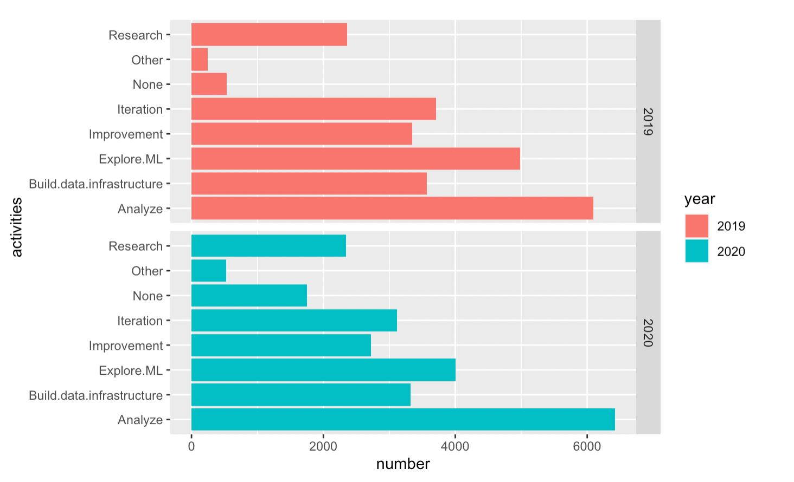
PART THREE Business Questions
Main programming activities distribution in 2019-2020

Slide 28
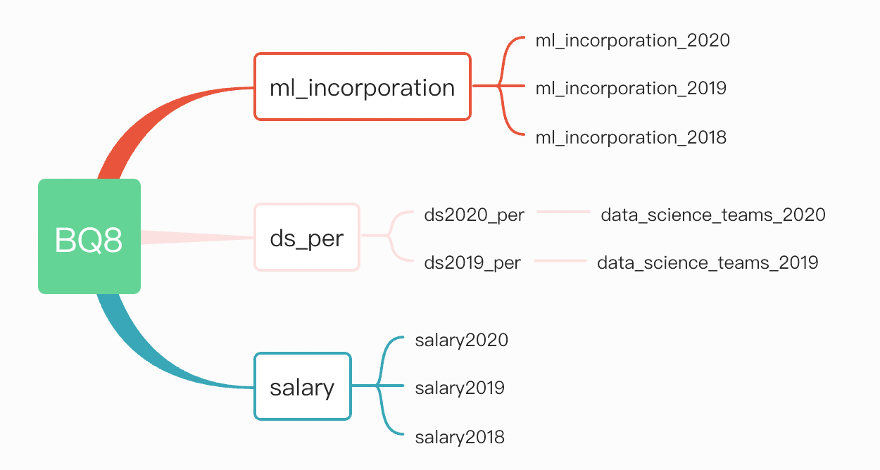
PART THREE Business Questions
Business Question 8
Predict the overview of Data Science and Machine Learning

Slide 29
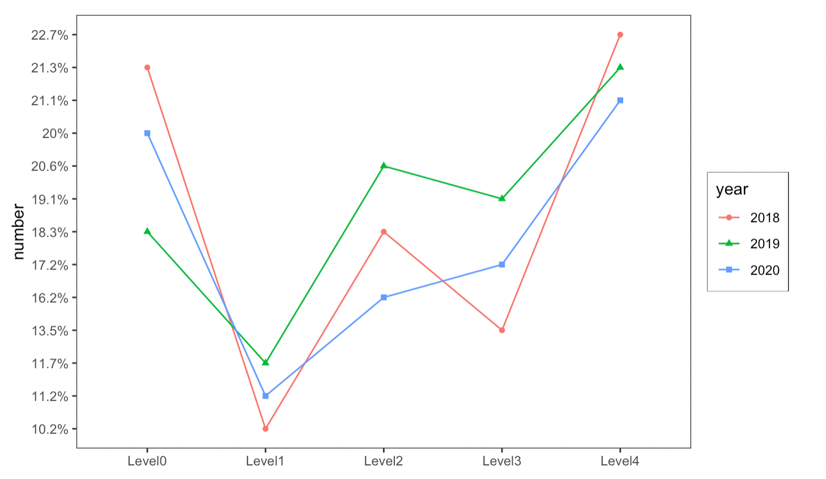
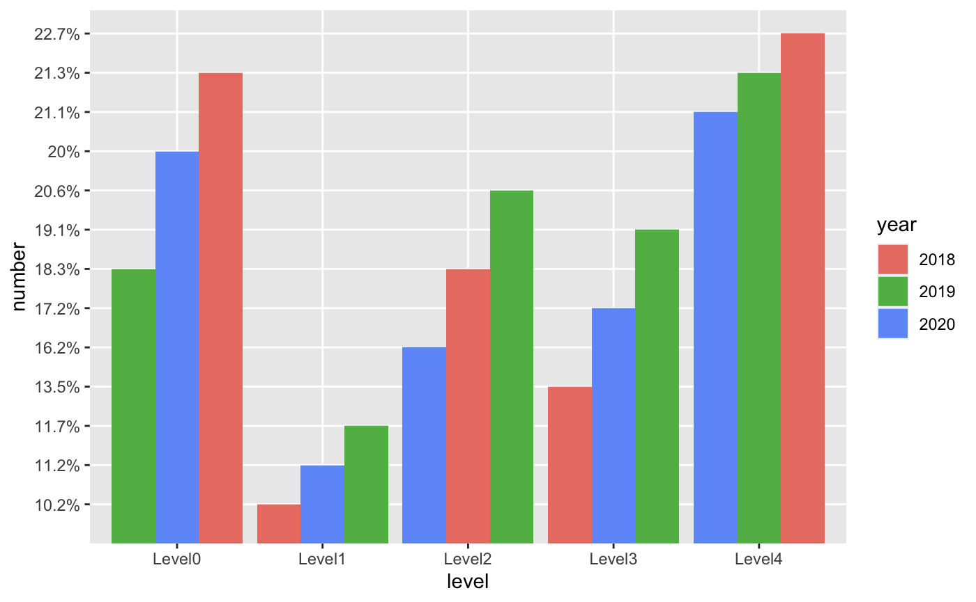
PART THREE Business Questions
Trend of levels of incorporating ML into business in 2018-2020
Distribution of levels of incorporating ML into business in 2018-2020

Slide 30
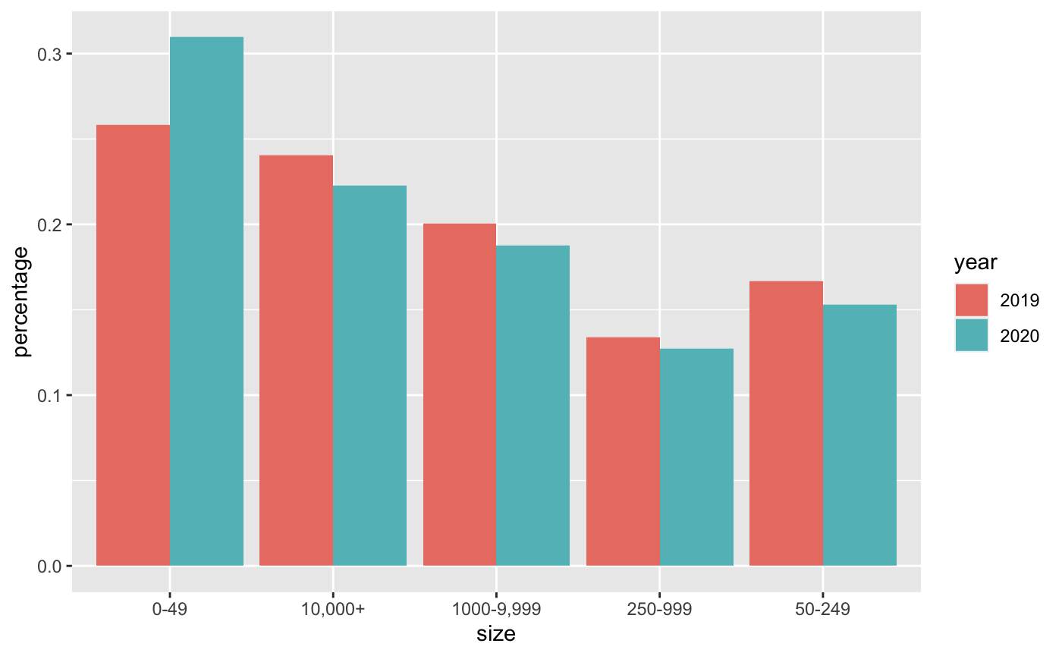
PART THREE Business Questions
Distribution of company size in 2019-2020

Slide 31
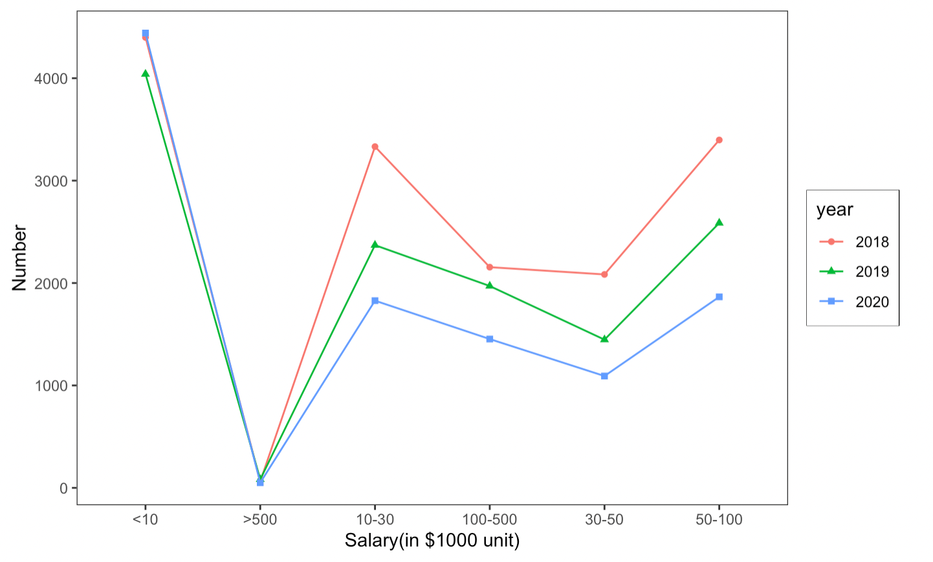
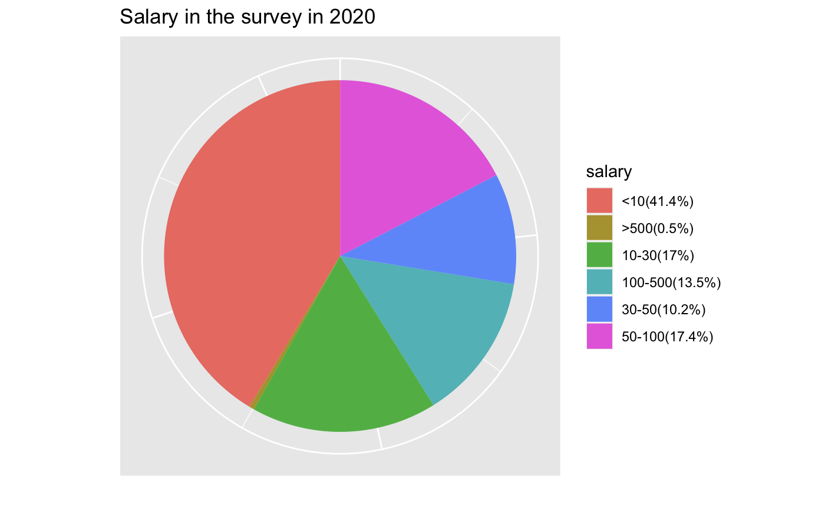
PART THREE Business Questions
Trend of participants’ annual salary in 2018-2020
Percentage of participants’ annual salary in 2020

Slide 32
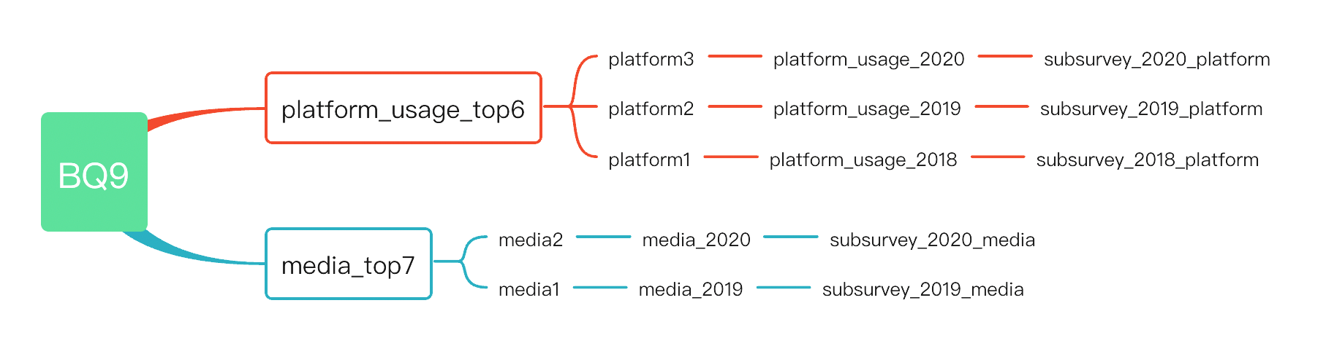
PART THREE Business Questions
Business Question 9
Compare market share of Kaggle within recent years

Slide 33
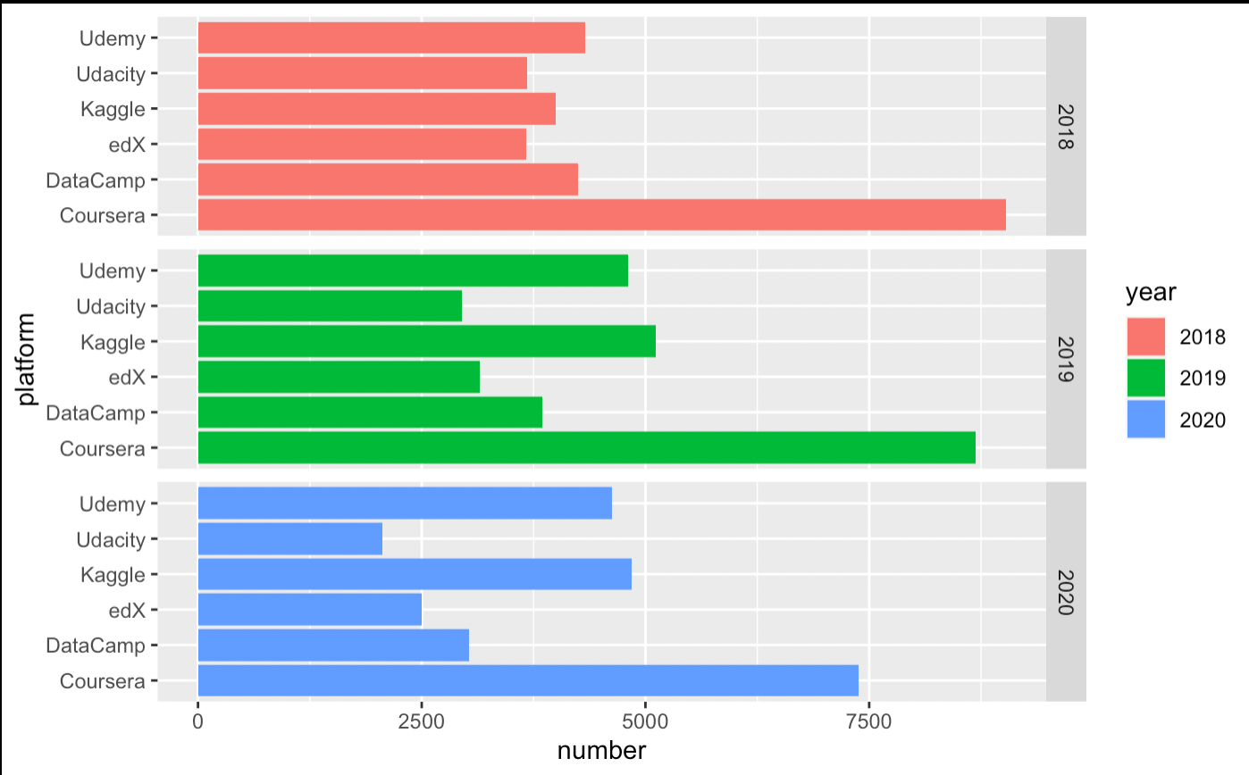
PART THREE Business Questions
Distribution of top six platforms with the largest number of registered DS courses in 2018-2020
Notes:
2018: Coursera > Udemy > Datacamp > Kaggle
2019: Coursera > Kaggle > Udemy >Datacamp
2020: Coursera > Kaggle > Udemy >Datacamp

Slide 34
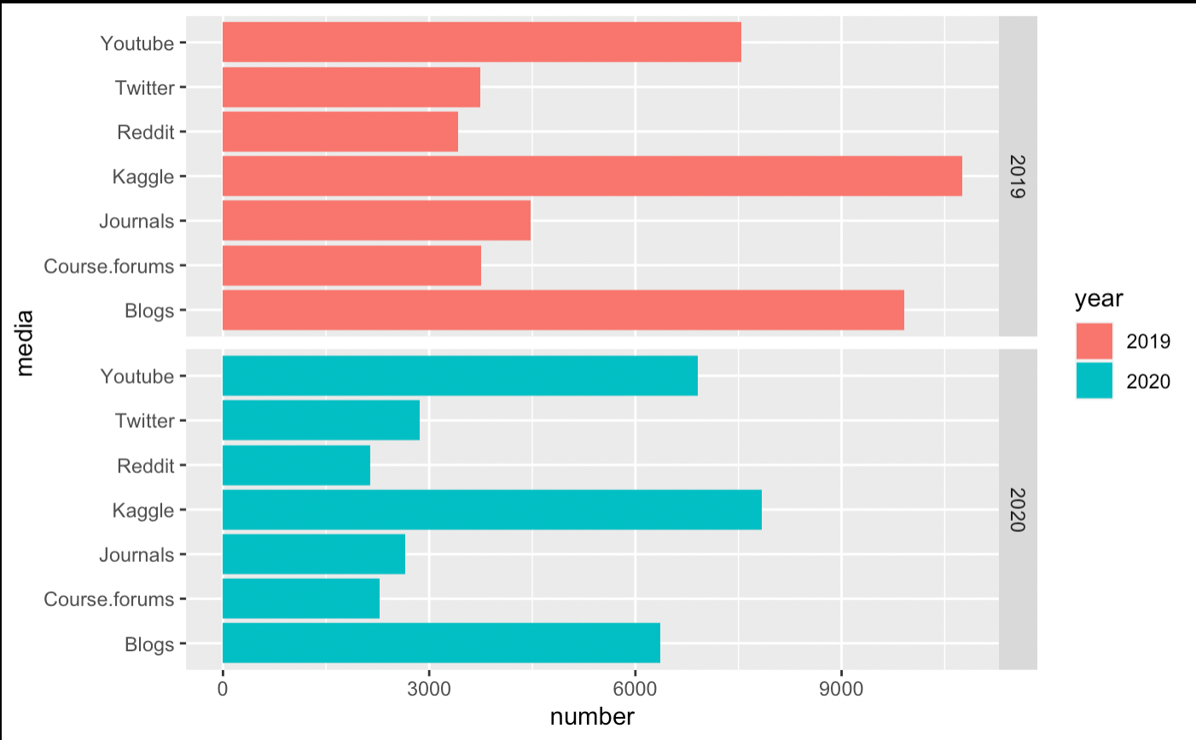
PART THREE Business Questions
Distribution of top seven media sources that report on DS topics in 2019-2020
Kaggle is the most popular media source.

Slide 35
Recommendation
PART FOUR

Slide 36


PART FOUR RECOMMENDATION
1
Advertising
Increase cost
Expand the marketing
2
Competition
More competition to promote initiative.
3
More chances
More people know different coding languages.
4
Promotion
Better space to improve ability.

Slide 37

Thank You!
Group 9
Jiangying Zhong
Zheng Lu
Ziyi Zheng

